Slide 1
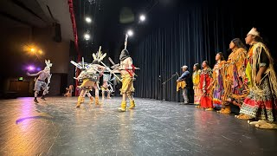

Slide 2



Culturally Responsive Trauma-Informed Care: Our Journey Towards Shiłgozhóó
San Carlos Unified School District
San Carlos, Arizona
Presenters
Jason Jones, High School Cultural Success Coach
Randy Begay, Cultural Support Coordinator

Slide 3
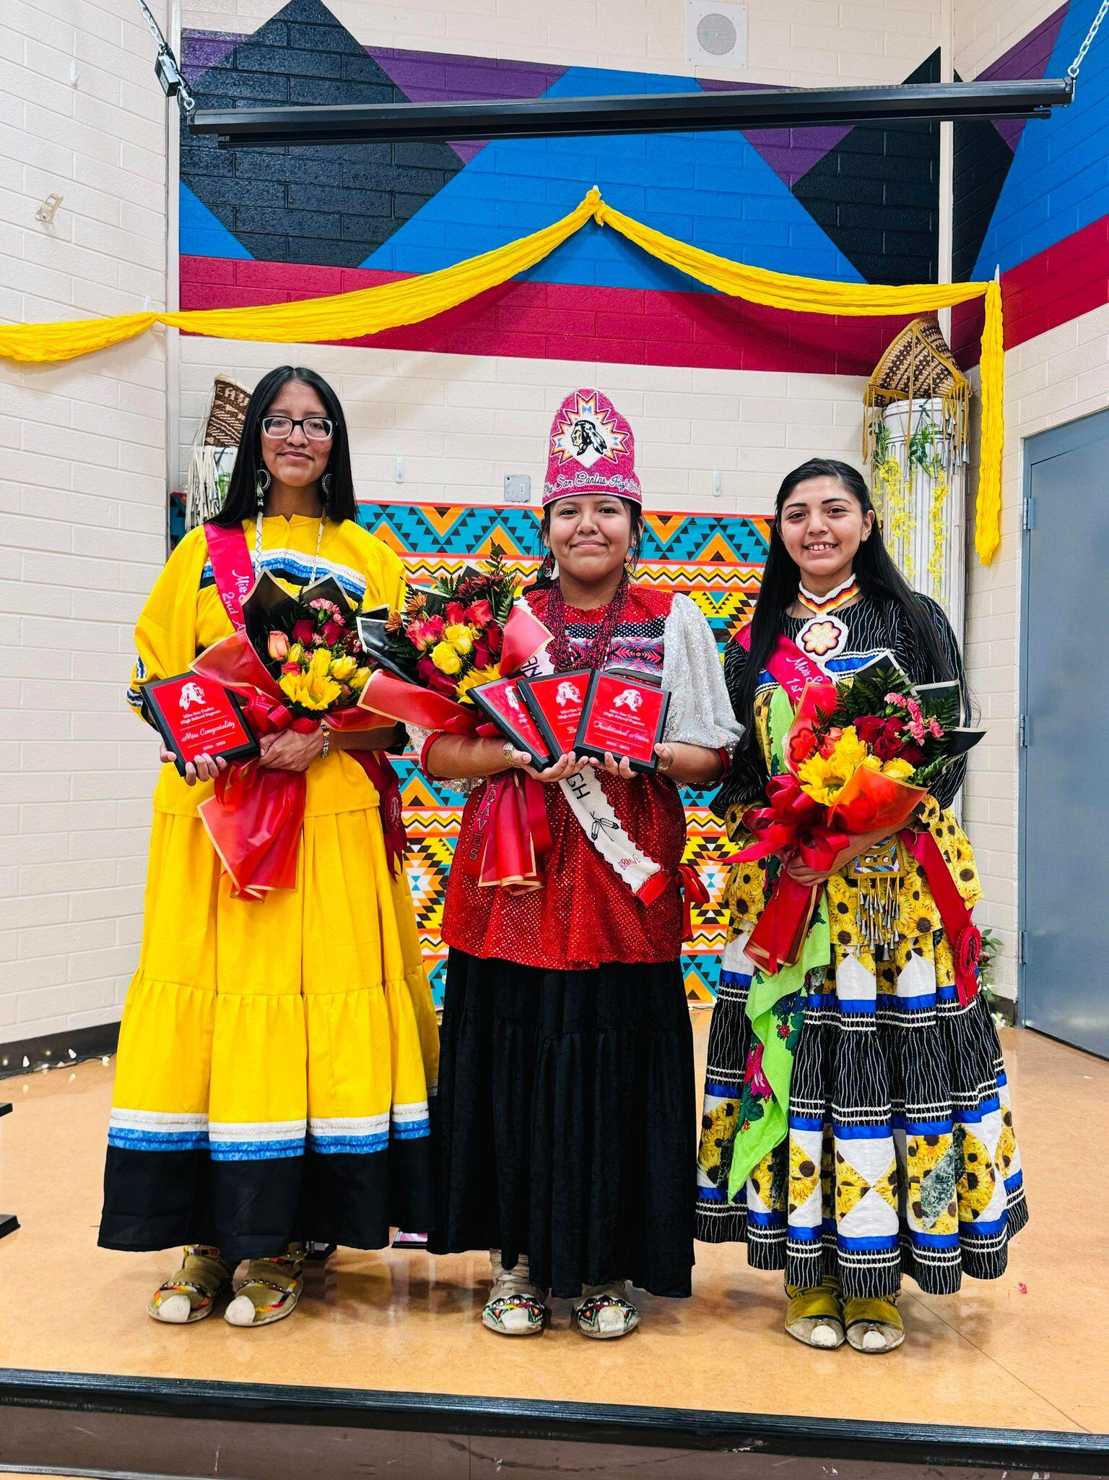
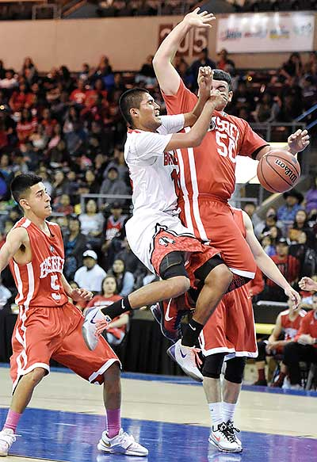
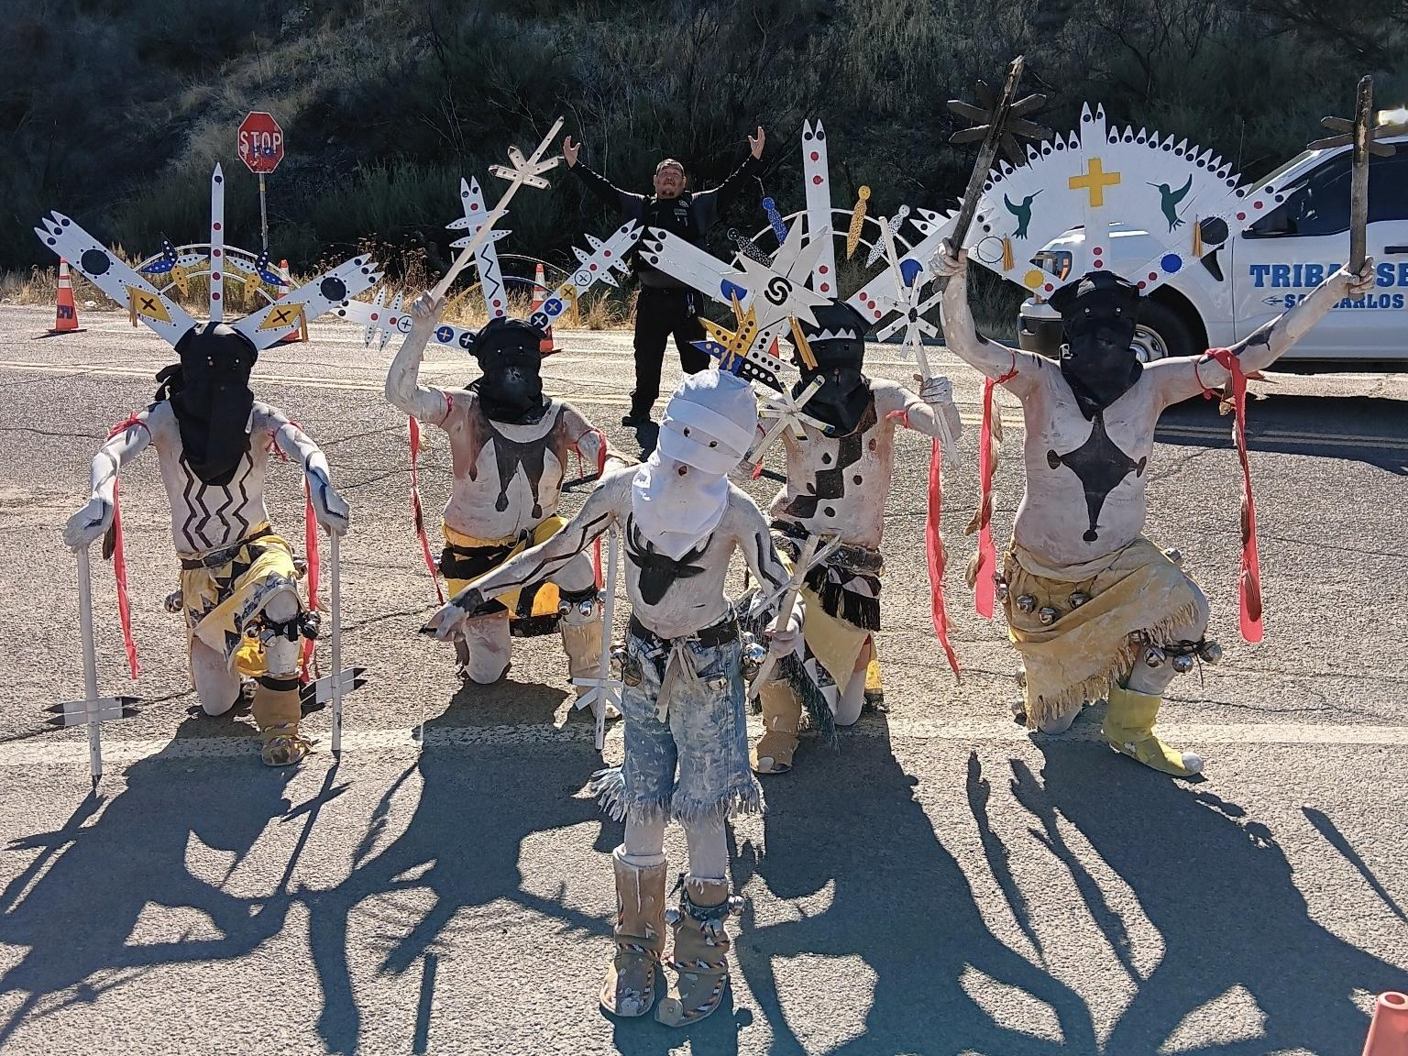
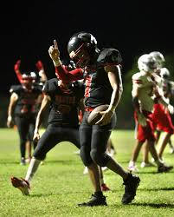
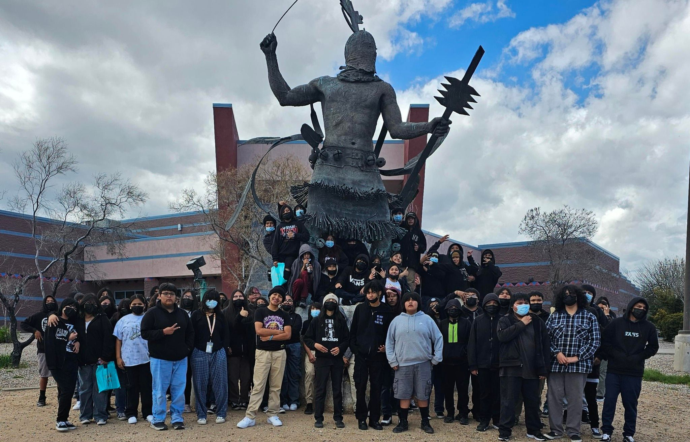
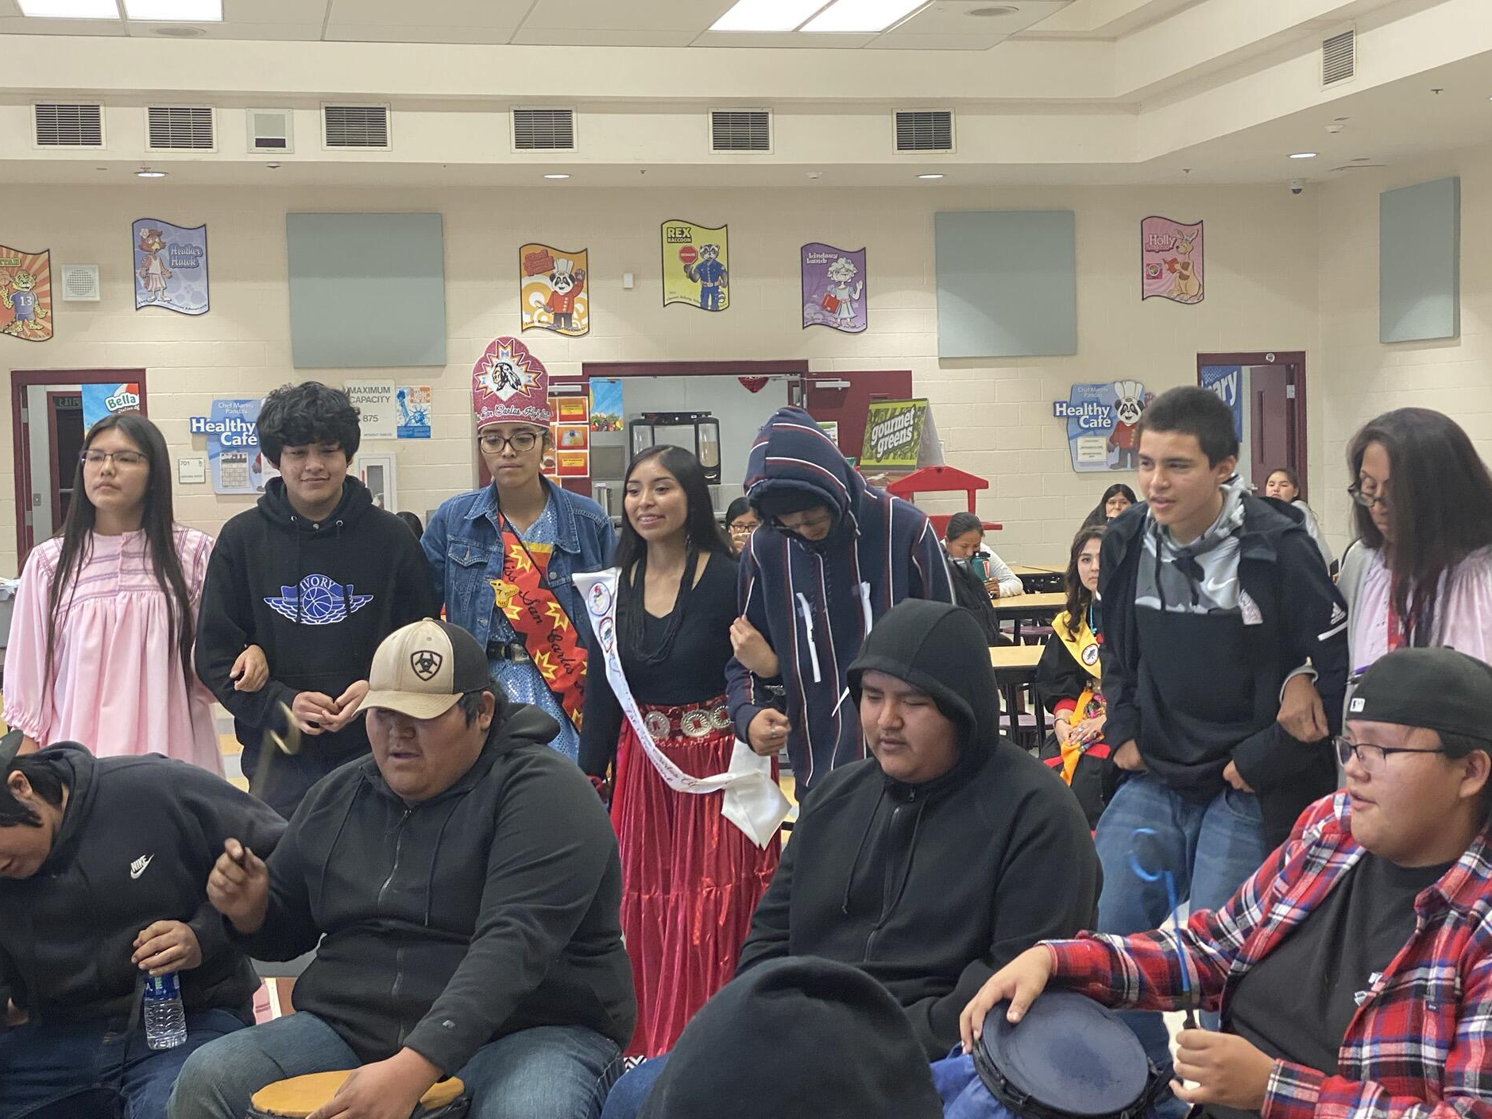
San Carlos Unified School District
San Carlos, Arizona

Slide 4
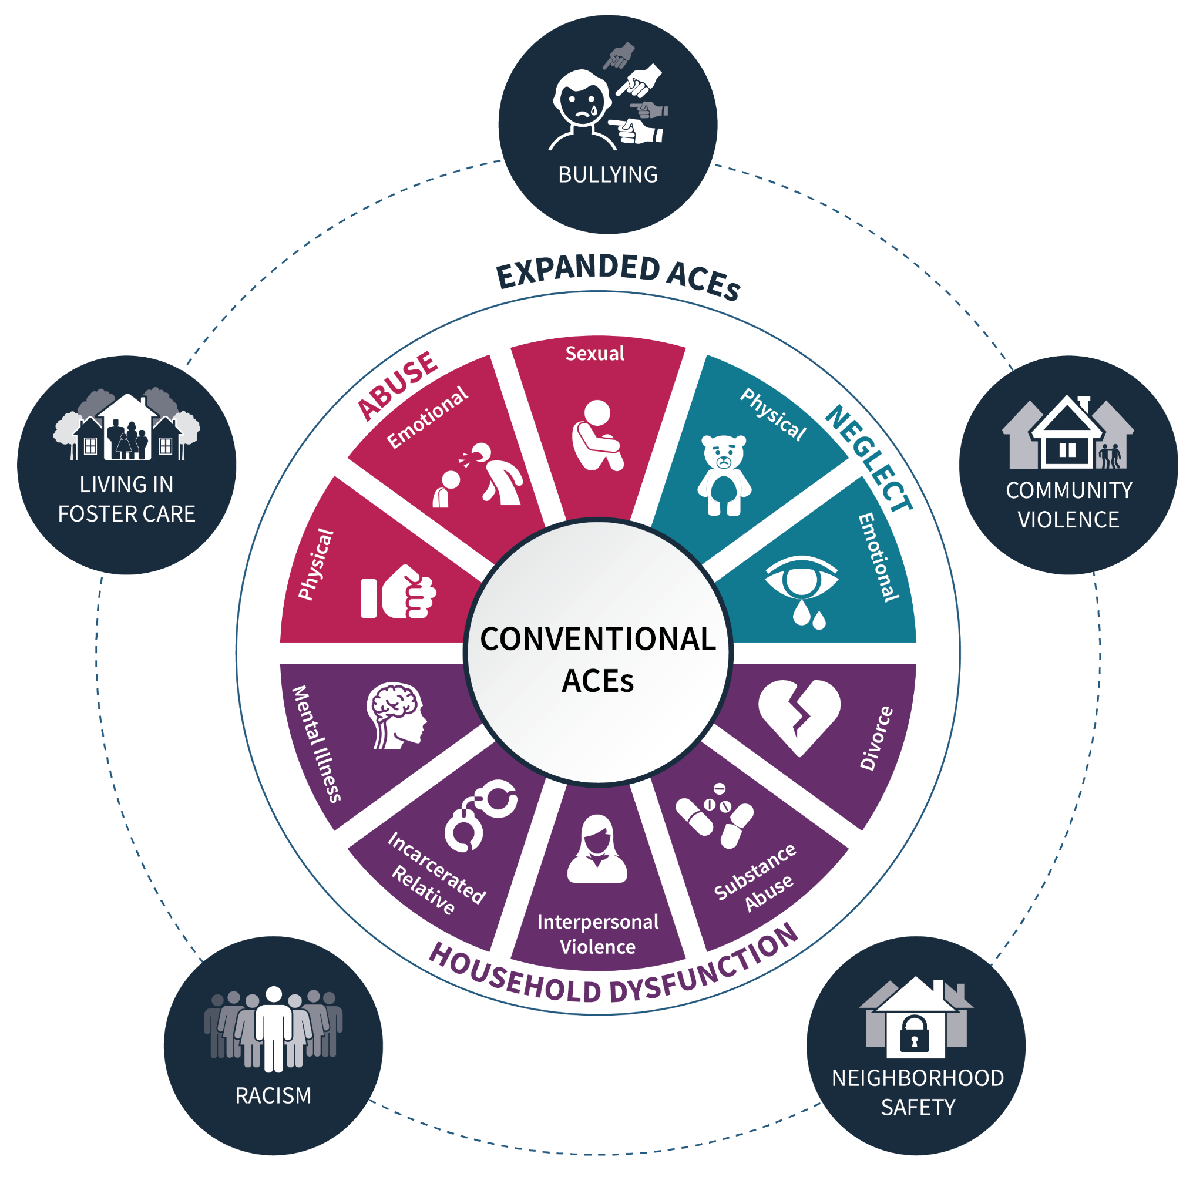
What are ACEs?
ACEs are Potential Trauma that happen before the age of 18.
Physical Abuse
Truancy
Non-Compliance
Emotional Abuse
Sexual Abuse
Substance Abuse
Emotional Neglect
Medical Neglect
Educational Neglect
Suicidal Ideation
Substance Abuse
Self-Harming
Divorce
Domestic violence
Incarceration of Care Giver
Poor Academic Performance
Mental Illness
Depression
Bullying
Homelessness
Anxiety
Poverty
Low Self-Esteem
Grief
Community Violence
Physical and Verbal Aggression

Slide 5
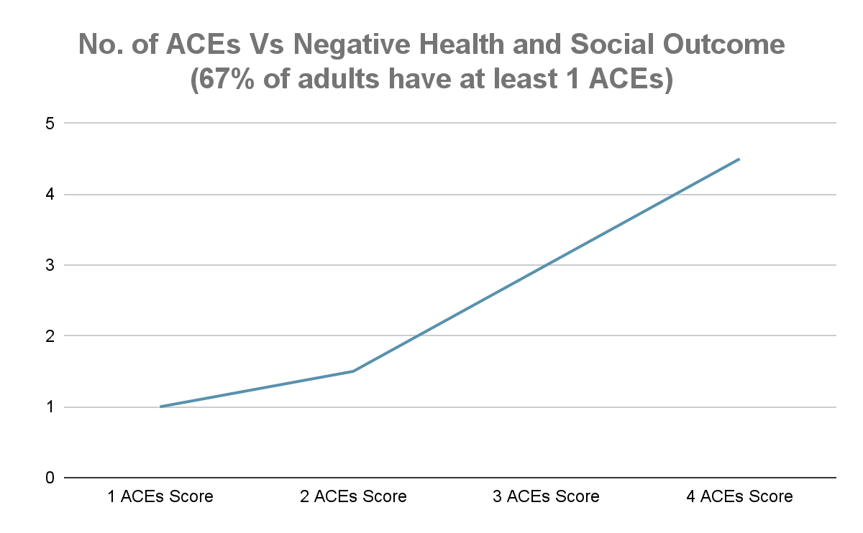
This is why it is crucial that we, as educators, understand ACEs and their effects on children’s ability to learn, engage, and feel safe in school.

Slide 6
Trauma-Informed Care Framework
Trauma-Informed Principles
Create Environments that are Safe and Understanding of Trauma Survivors.
Serves as a guide for Cultural Responsive Support Services.
2. RECOGNIZE
1
SAFETY
Create a secure and welcoming environment that is not-threatening.
1.UNDERSTAND
5. AVOID and RESIST RE-TRAUMATIZATION
The prevalence and impact of trauma and adversity.
The effects of trauma and adversity.
2
TRUSTWORTHINESS
Build trust with students and involve them in decisions with transparency.
Non-judgmental support is key to preventing re-traumatization from occurring when approaching a student who have experienced ACEs and/or other adversities.
3
PEER SUPPORT
Integrate shared experiences is key to building safety, trust, and healing.
3. RESPOND
4. INTEGRATE
4
COLLABORATION
Foster mutual support and partnership.
by fostering safety, trust, and empowerment.
Integrate knowledge into practice. Trauma awareness and trainings.
5
EMPOWERMENT
Foster student resilience and personal strengths working toward self-advocacy
6
CULTURAL RESPONSIVE
Culturally responsive practices focusing on cultural needs and address historical trauma.
Professional Development: Mandatory Reporting, QPR and SafeTalk suicide prevention, Youth Mental Health First Aid, Common Wealth SEL, Adverse Childhood Experiences (ACEs), Drug Impairment Training for Education Professionals, Practical Trauma-informed Strategies, Nonviolent Crisis Prevention Intervention (CPI).
It's important to understand that students' experiences are shaped by their cultural environment. Culturally Responsive involves recognizing the significance of culture. So, we tailor our support strategies to meet the unique needs of each student, respecting their cultural values and experiences.

Slide 7
“Recognizing Adverse Childhood Experiences and adopting trauma-informed, culturally responsive practices, we are paving the way for student success despite challenges. As educators and administrators, we are dedicated to breaking barriers and creating safe, supportive environments where every child can thrive.”
Thank you for your attention. Together, we can make a meaningful difference in building resilience and empowering our students.

Slide 8
C.A.R.E. CENTER
(CULTURAL SUCCESS COACH)

Slide 9
C.A.R.E.
What do you think of when you see the word CARE?
Care Center conception..
An Acronym

Slide 10
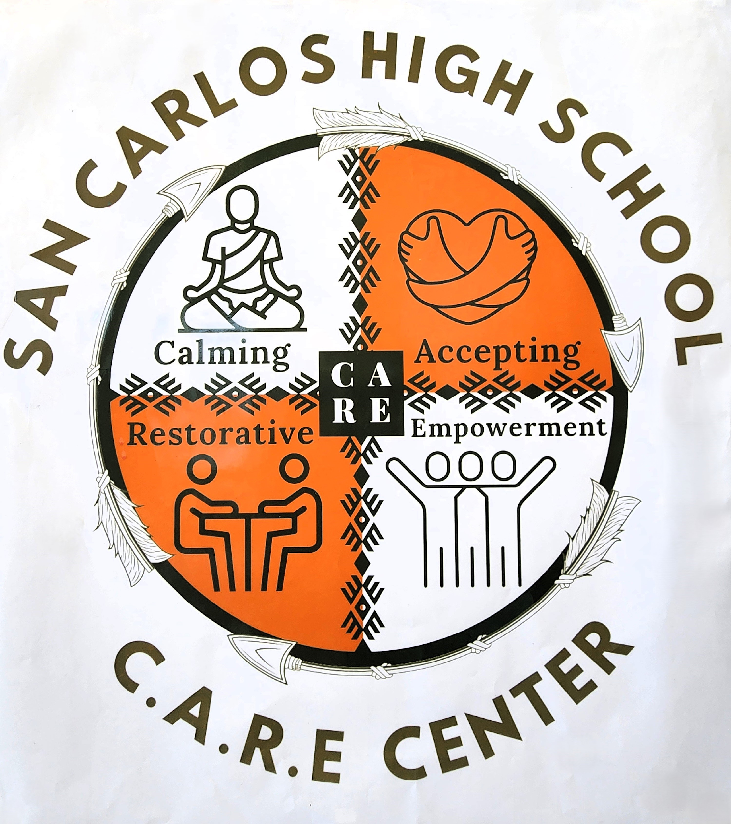
C.A.R.E.
C-Calming
A-Accepting
R-Restorative
E-Empowering

Slide 11
C.A.R.E.
Self Esteem
Truancy
Basic Needs

Slide 12


C.A.R.E.
Services Provided
Hygiene Care
Clothing
Academic Support

Slide 13
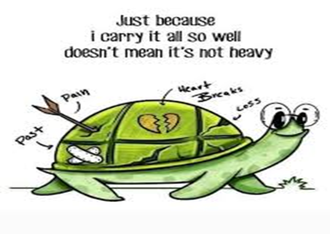
C.A.R.E.
Trauma, ACE’s
Mental Health
Social-Emotional Support

Slide 14
C.A.R.E.
Mr. Jason Jones
Cultural Success Coach
San Carlos High School/San Carlos Unified School District #20

