Slide 1

Building an Effective Tribal Consultation Model
Presenters: Dr. Lolita Ceja, Indian Education Director
Dr. Toron Wooldridge, Superintendent
Toppenish School District

Slide 2
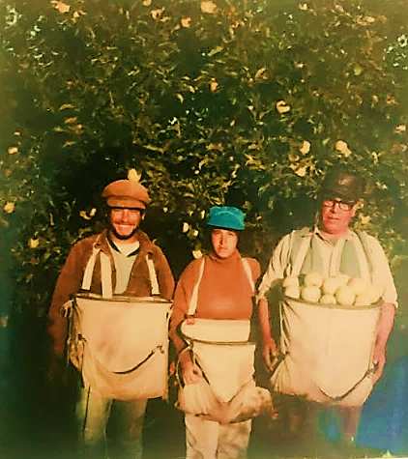
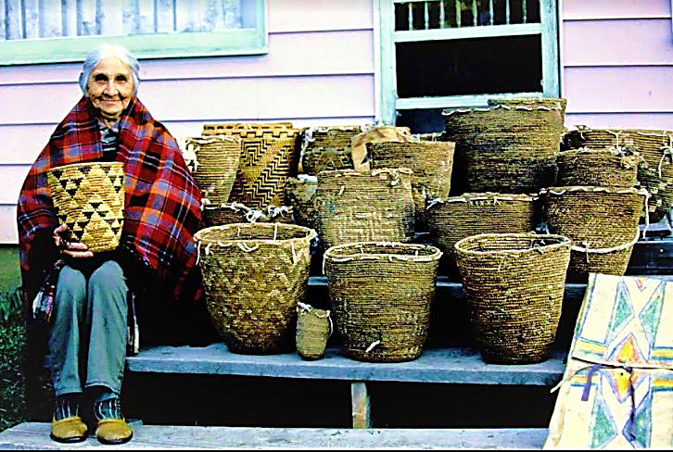
HOW I SHOW UP,
WHY THIS IS IMPORTANT
ENERGY
LEGACY

Slide 3
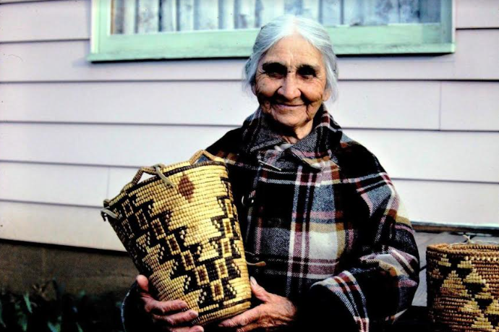
Ida Nason Aronica was an influential Kittitas Band tribal elder and the great-granddaughter of Chief Owhi.
Ida Nason Aronica Elementary

Slide 4
PURPOSE AND LEARNING OBJECTIVES
Provide an effective Tribal Consultation model between LEAS and Tribes. This model upholds the objectives and guidelines under the Indian Policies and Procedures (IPP) in the Impact Aid application. Participants will receive a template on the pathway to ensure meaningful opportunities to provide input, feedback, and recommendations on education policies, programs, and services that impact the success of American Indian/Alaska Native (AI/AN) students.
Demographics and Facts
Brief History of Indian Policies and Procedures (IPPS) and how TSD was meeting the expectations
Tribal Consultation Example
Buy-in and ability to collaborate voices, perspectives, resources, and breakdown stereotypes and build up relationship trust.
Positive District-wide Outcomes

Slide 5
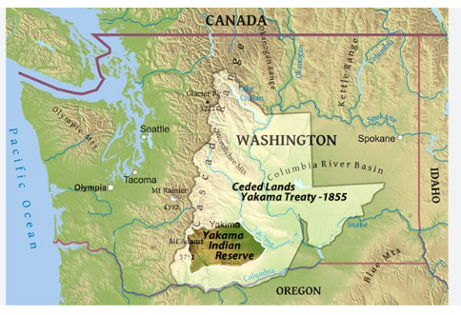
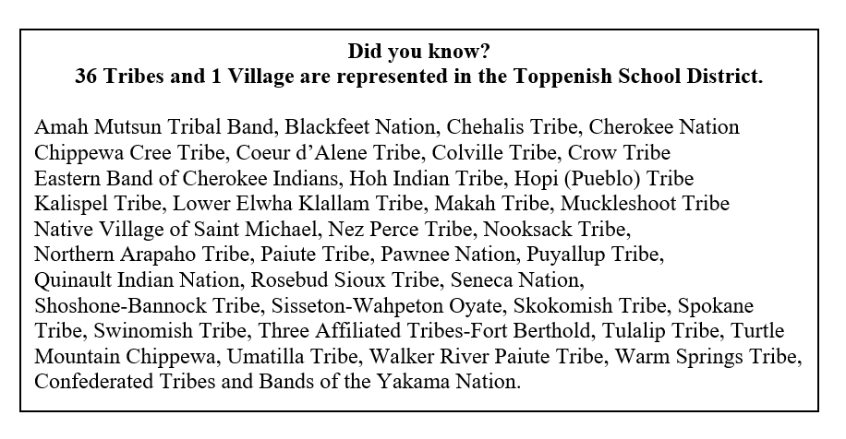

Facts about the Toppenish School District
4526 -Students enrolled
3466 -Onsite
1060-Alternative Learning Students
202- Pre School
660 -Migrant Students
*112-AI/AN Migrant Students (16.9%)
524 –Special Services
625 – AI/AN = 14.6%
8 School buildings
•Preschool
•4 Elementary Schools (K-5)
•1 Middle School (6-8)
•1 High School (9-12)
•CATS (9-12)
* Cats Online (6-12)

Slide 6
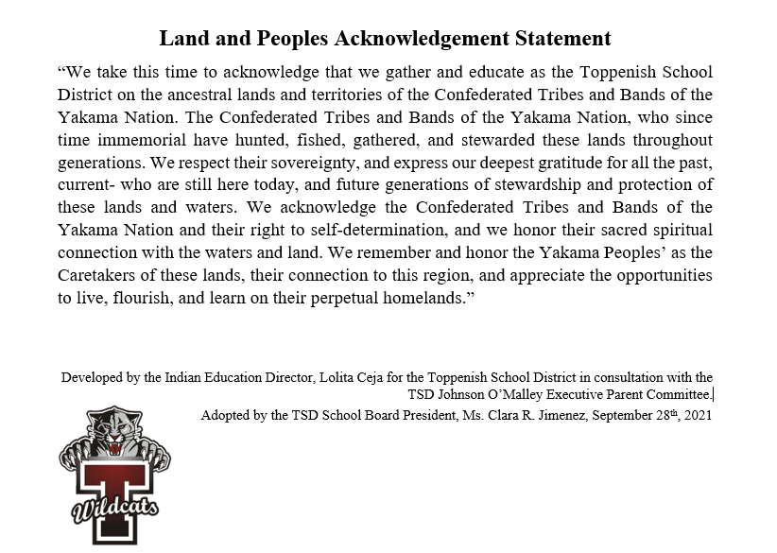
Indian Policies and Procedures (IPPs) ARE forms of upholding a Land and Peoples Acknowledgement.

Slide 7
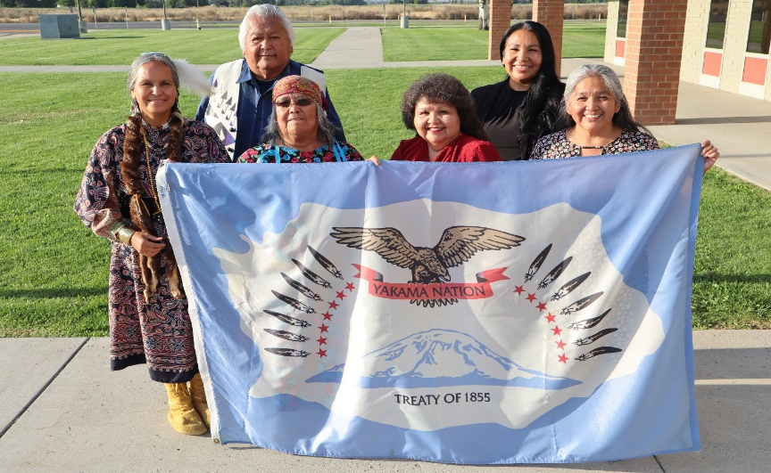
How many of districts have parent/teacher conferences?
How many of your districts have a land acknowledgement? Who created it? What is it used for?
WHERE DOES OUR DISTRICT BEGIN?
Toppenish School District's Indian Education Program would like to show appreciation and gratitude to our JOM/Title VI/IPP Executive Parent Committee for their years of service. Your voices, time, and knowledge have made a difference.
We Celebrate You!!
How many districts here have Title VI and/or JOM?

Slide 8
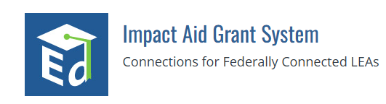
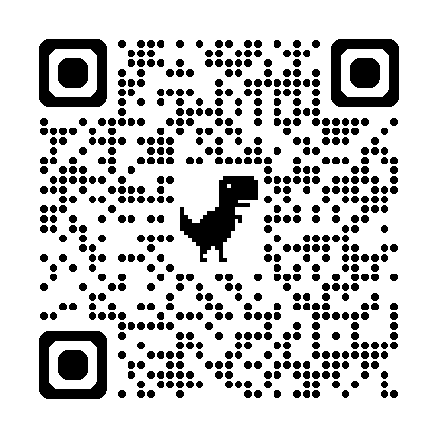
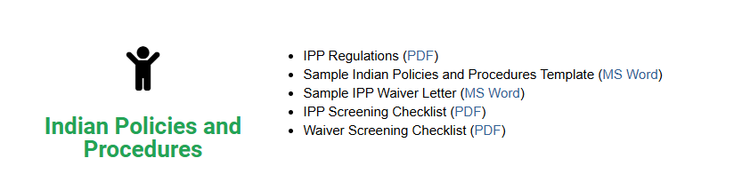
https://impactaid.ed.gov/resources/
SB 5252: CONCERNING SCHOOL DISTRICT CONSULTATION WITH LOCAL TRIBES
-The Government-to-Government Relations
-History of Tribal People in Washington State
-Identifying Native Students in Public Schools
-Agents of Change: School Leadership Behaviors and Dispositions
HB 1426 : Equity-based practices for cert.
-Yakama Nation Representative is a Permanent School Board Agenda Item (Jan 2019)
-IPPS are discussed throughout the Title VI and Johnson O’Malley Family Meetings (Prior 2019)
-All meetings (public notice is given on school calendar and designated time during meeting of public input is allocated each School Board meeting.)
-Spring and Fall Consultation with Tribal Council and General Council (Permanent since Spring 2019)

Slide 9
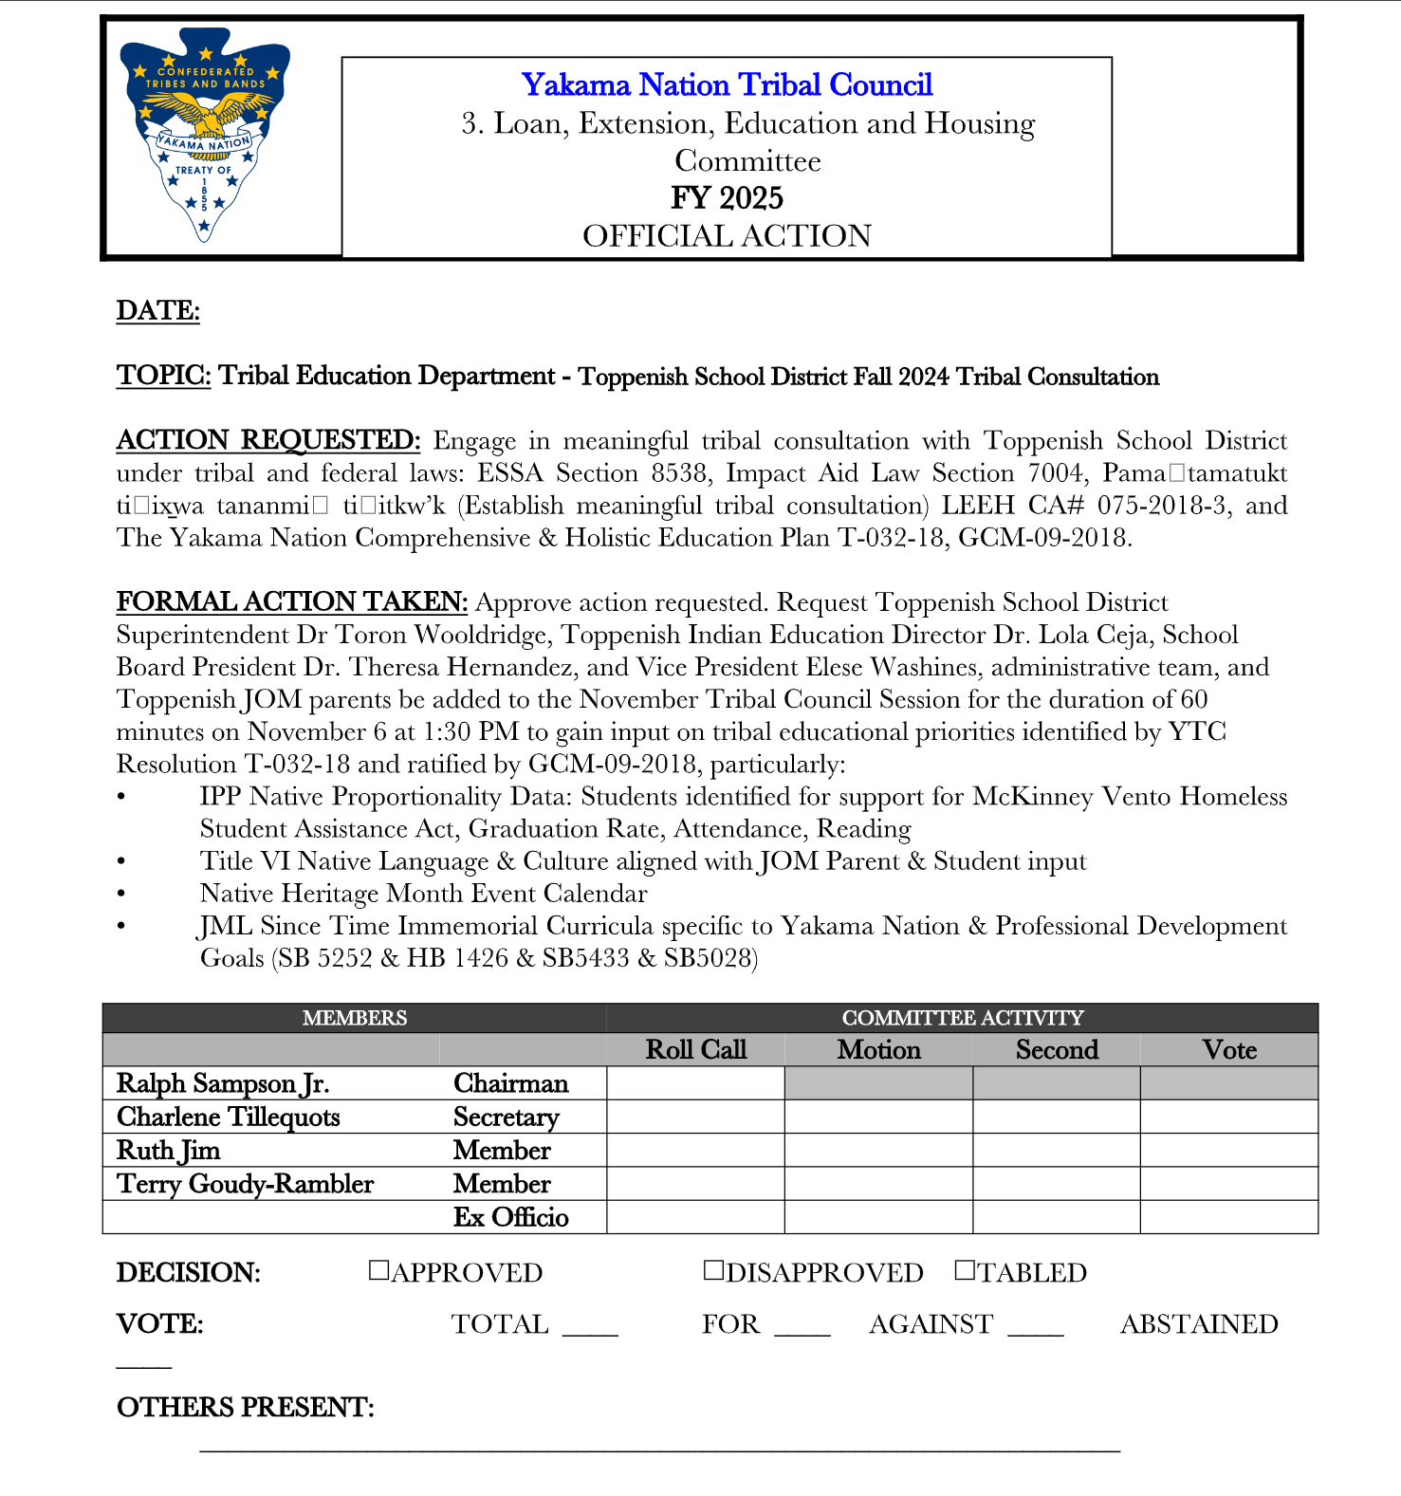
Step One -Scheduling Tribal Consultation
Positives: It allows Tribal and General Council information and the opportunity to ask any questions relating to how our District is upholding and applying the overall wellbeing and educational services to ALL our students. Partnerships, MOUS, Breaks down stereotypes.
Why do I say ALL? And not just the AI/AN students?
Challenges: Multiple Tribes, Delegate, Inquire about Tribal Educational Departments

Slide 10
Step Two -Gathering Tribal Consultation Priorities Requested
YN Consultation Request Items
IPP Native Proportionality Data:
McKinney Vento, Graduation, Attendance,
Reading, and Special Education
Title VI Native Language & Culture aligned with JOM Parent & Student Input
Native Heritage Month Event Calendar
John McCoy (lulilaš) listen to how lulilaš is pronounced Since Time Immemorial Curricula specific to Yakama Nation and Professional Development Goals (SB 5252 & HB 1426)
Positives: Transparency, accountability, and voice recommendations.
Builds Community; and allows LEA Educators and Staff to view Tribal Leaders that affirms Tribal Sovereignty
Challenges: It takes a whole team to provide data and have it readily available for explanation.

Slide 11
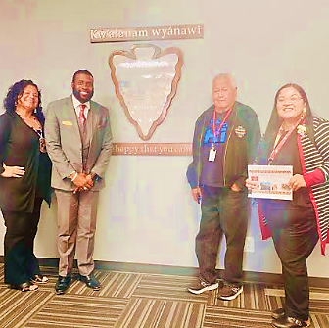
Step Three –What does our LEAS Presentation Look Like
Audience: Tribal Council and General Council
Setting: Tribal Chambers
Presenters: L-R Dr. Ceja Indian Education Director, Dr. Wooldridge Superintendent, Ronnie Washines JOM/Title VI Parent Executive Committee Member, Elese Washines School Board Vice Chair
Timeframe: 1 hour or maybe 3 hours

Slide 12
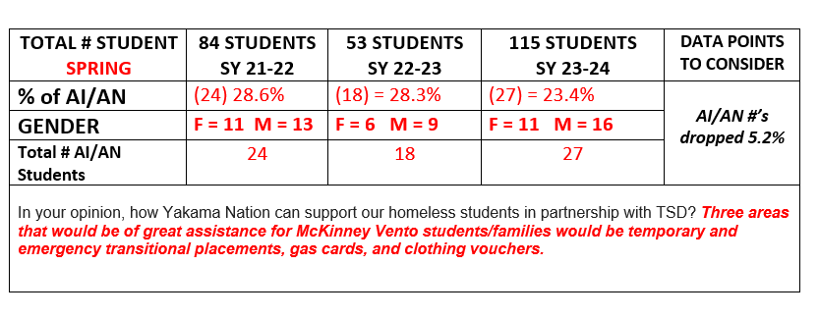
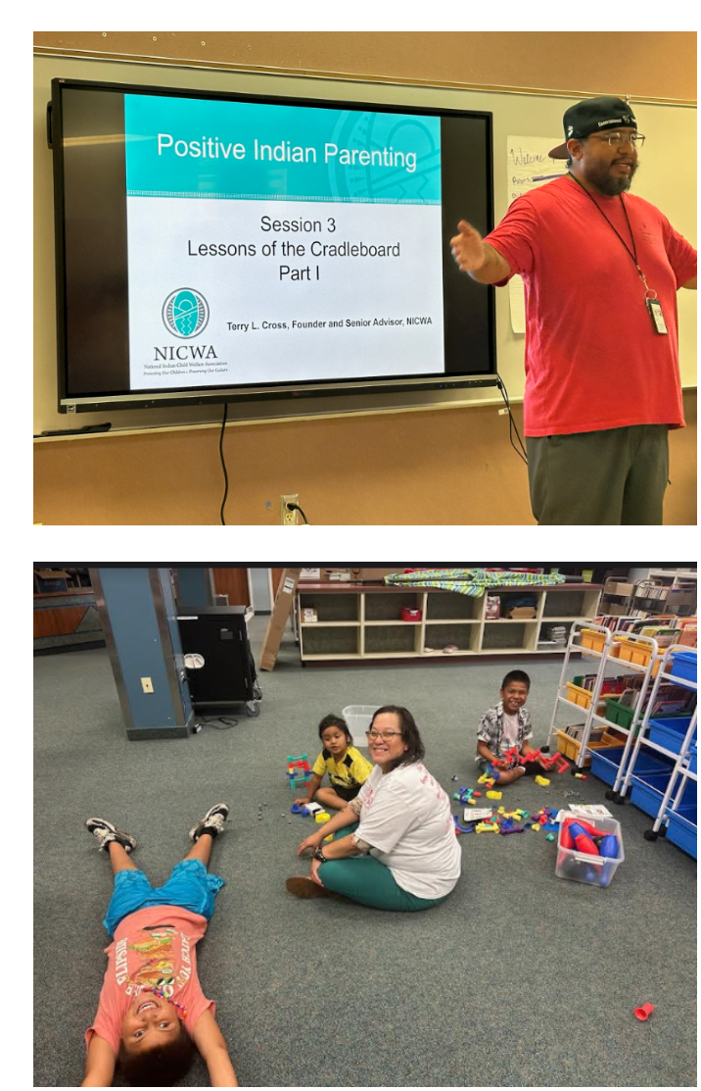
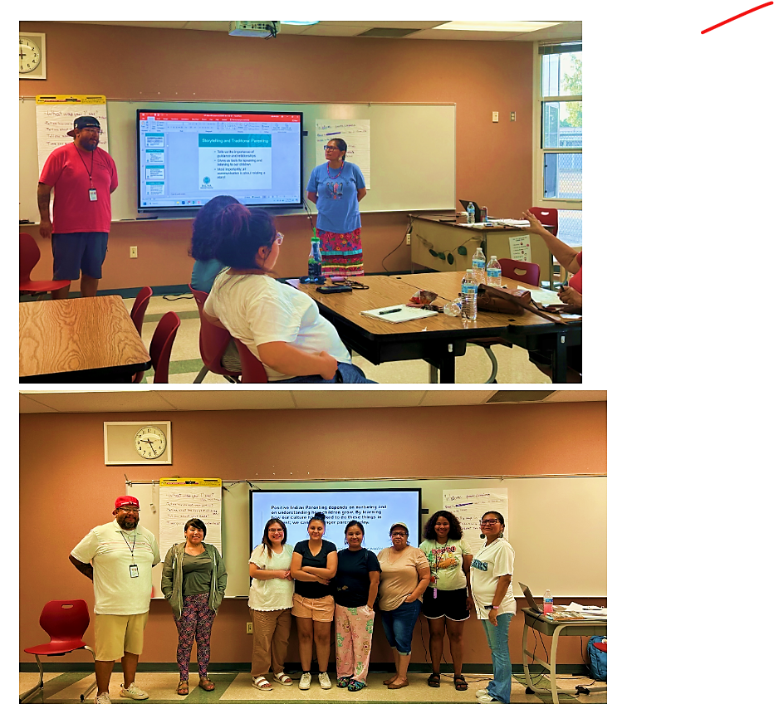
McKinney-Vento
Homeless Student Assistant Act
Student Education Needs-Costs Associated
Medical /Mental Health/ Shelter Support
School Transportation
Key Partnerships:
Indian Health Services (IHS)Nak-Nu-We-Sha, Kinship Program, Village of Hope, Youth Activities, and *Behavioral Health Services
(Presenters: Bobbyjoe Ashue and Sophie Elwell, )TISS Grant
Three areas that would be of great assistance for McKinney Vento students/families would be temporary and emergency transitional placements, gas cards, and clothing vouchers.

Slide 13
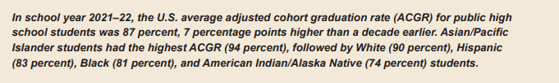
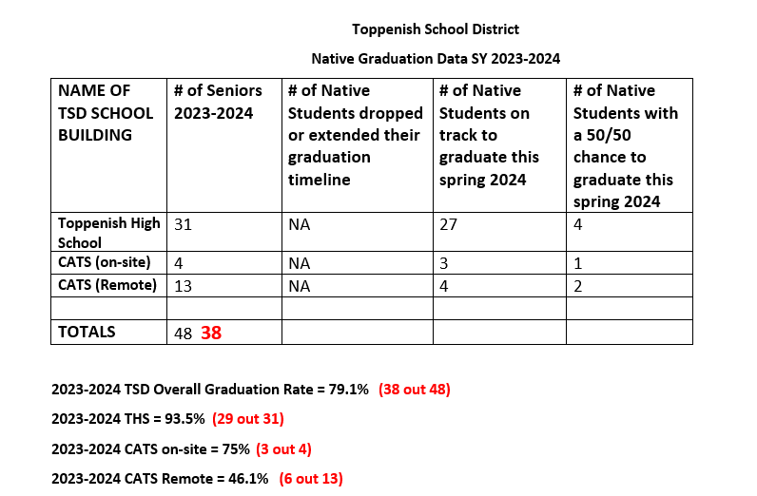
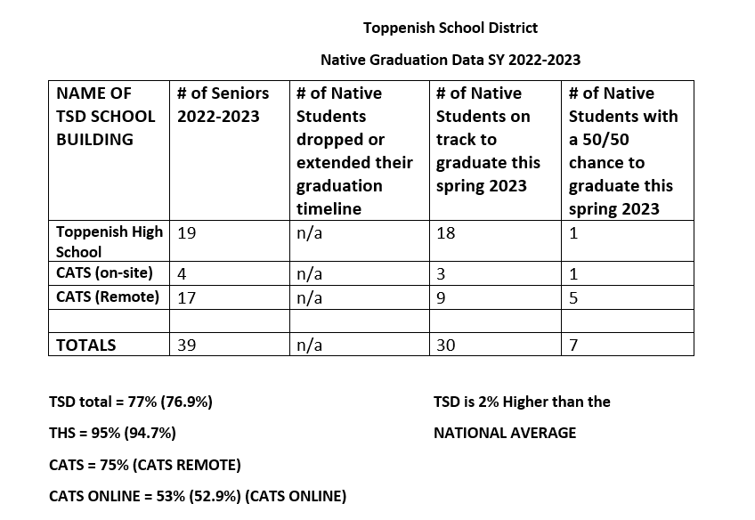
TSD NATIVE GRADUATION DATA
SY 23 vs SY 24
IES NCES National Center for Educational Statistics
Last Updated: May 2024
IES NCES 2022-23 AI/AN 76.9%, TSD 2.9% higher and a 1% overall higher one year later
IES NCES 2023-24 AI/AN 79.1%, TSD 5.1% higher and a 2.2% overall higher one year later

Slide 14
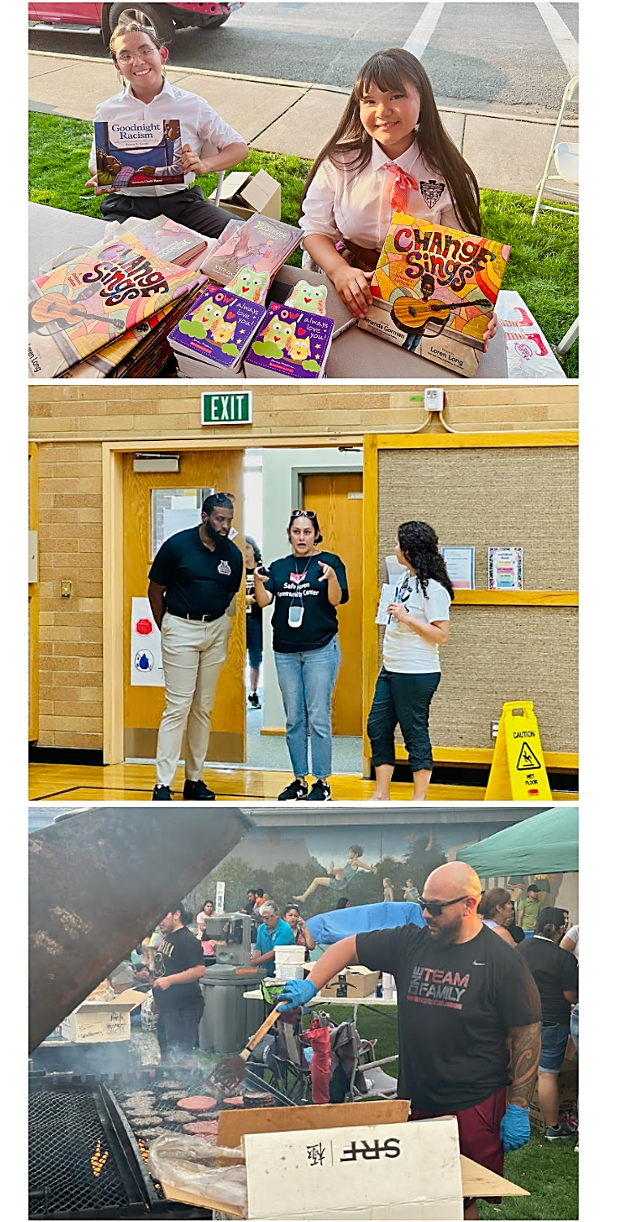
TSD READING DATA
Smarter Balance Assessments (SBA): 2023-24
Washington Comprehensive Assessment of Science (WCAS): grade 5, 8, and 11
Reading Scores 3-8 and 10
TSD All Students: ELA 21.3%
AI/AN: ELA 19.7%
Science: grade 5, 8, and 11
TSD All students: 18.3%
AI/AN: 27%

Slide 15
Risk Ratio American Indian/Alaskan Native students are 2 times more likely than all other students to have 18 or more absences.
American Indian/Alaskan Native students' representation among students who are chronically absent is 7 percentage points higher than expected given American Indian/Alaskan Native students' percentage of the student body.
WE HAVE SEEN OVERALL INCREASE SINCE COVID
Yakama Nations Children Code
PAGE 45
As you know there is a separation of jurisdiction for tribal members and wanted to make sure you are aware of Truancy law specifics.
Please see the attached “Wat-twee pawah Miiyanushma” Revised Yakama Children’s Code.
Tribal Council made revisions to RYC Title 80 Children’s Code under Tribal Council Resolution T-059-24.
Chapter 4 – Truancy (page 45-61) was updated in the following areas:
80.04.110: Purpose of Chapter
80.04.125: Parties in Truancy Proceedings
80.04.130: Removed
80.04.170: Parent and Student – Appearance at Hearing
80.04.180: Failure to Appear
80.04.310: Truancy Officer Authority and Responsibilities
80.04.330: Initial Action Upon Child’s Failure to Attend School
80.04.340: Truancy Remediation Plan
80.04.630: Penalties
Create effective teams
Becca Conference Nov. 7 & 8
Partnership with ESD and YN Tribal Truancy Team (Arlen Moses)
Weekly Attendance Service Data
Community Truancy Board Meetings
Tribal Truancy Court Restrictions

Slide 16

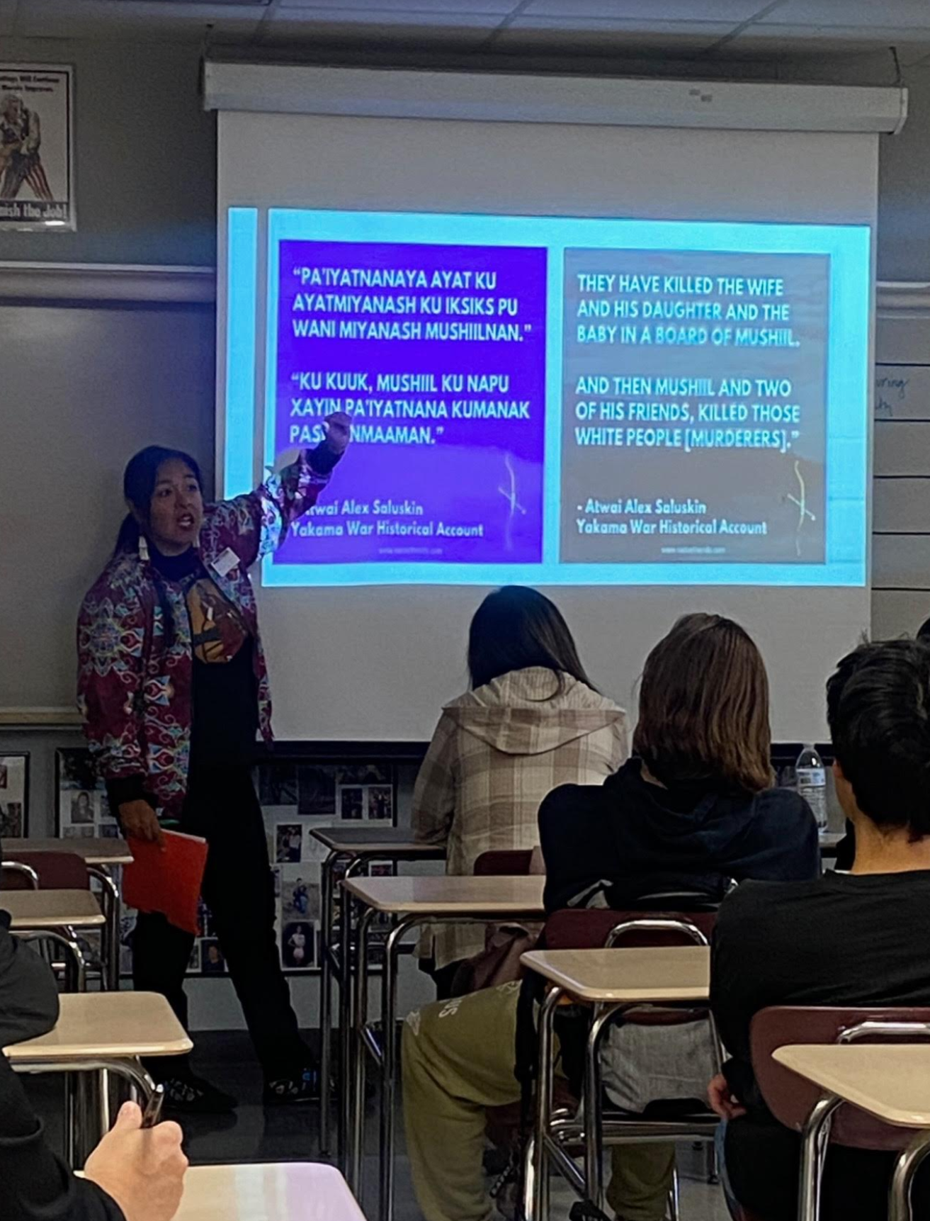

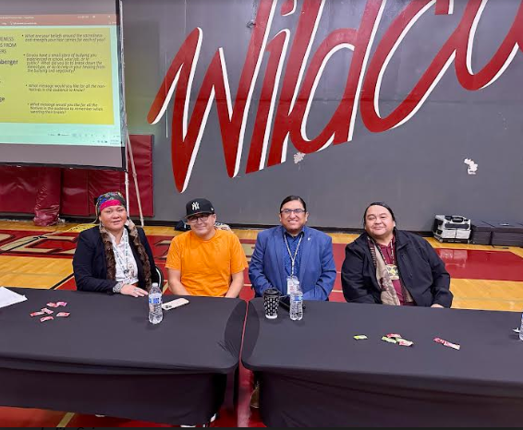

TITLE VI NATIVE LANGUAGE & CULTURE ALIGNED WITH IPP PARENT & STUDENT INPUT
CULTURE AND TRADITION
Representation: “Boys with Braids” assembly Middle School
Curriculum: “Yakama specific” History in the classroom interwoven with implementation of the John McCoy Since Time Immemorial Curriculum
Goal: Increase CTE #’s and create courses that are tribal specific and build partnerships in forest management, dealer/gaming, firefighting, and flagging.
LANGUAGE
Representation: More language displayed or visible in the buildings
Curriculum: Language in the classroom interwoven with implementation of the John McCoy Since Time Immemorial Curriculum
Goal: Seal of Biliteracy for Toppenish

Slide 17
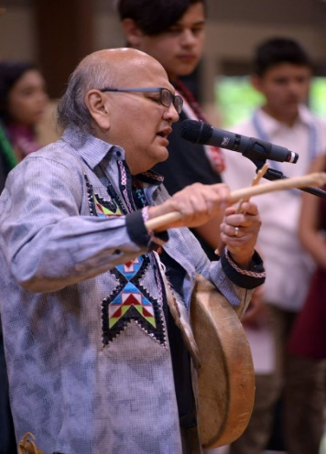
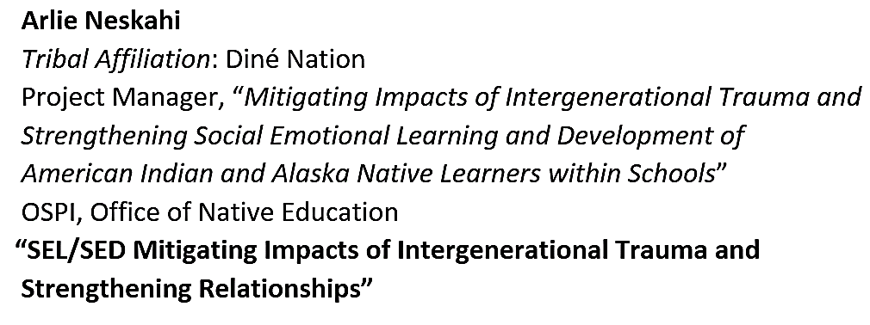
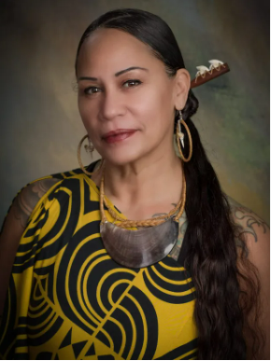
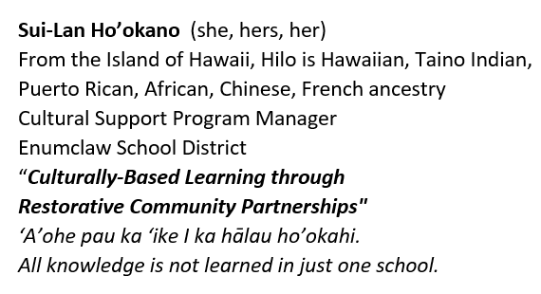
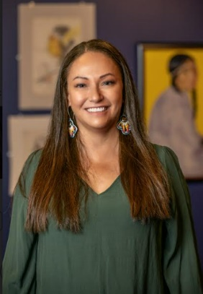
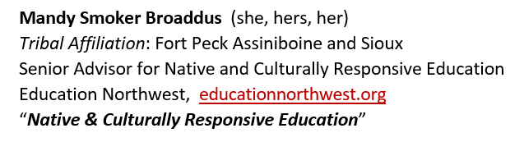
John McCoy Since Time Immemorial Curricula specific to
Yakama Nation & Professional Development Goals
(SB 5252 & HB 1426)
SY 2022-23 March 31st, 2023
-Is the FIRST in TSD history for an Optional-Day of
Professional Development Day dedicated
to Indigenous Scholars Agenda
186 out 238 = 78.1% Certified Staff
86.2% Administrators (Pilot of G2G with Maxine Alex)
SY 2023-24 March 29th, 2024
(2) Specific STI Trainers and each Elementary and
Secondary received 3 hours for grade level
OSPI Office of Native Ed. And Yakama Nation Language Program
103 out of 238 = 43.2% Certified Staff
Additional STI Trainings TSD Staff have Attended
November 7th, 2023 (OSPI) Office of Native Education @ Heritage University
4 TMS Teachers attended Professional Development provided by
Tribal Leaders and Educators
1 Indian Ed. Director
July 13th, 2024
1 TMS Teacher attended Enduring Legacies Native Cases Initiatives
1 Indian Ed. Director

Slide 18

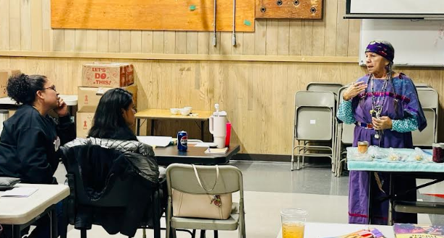
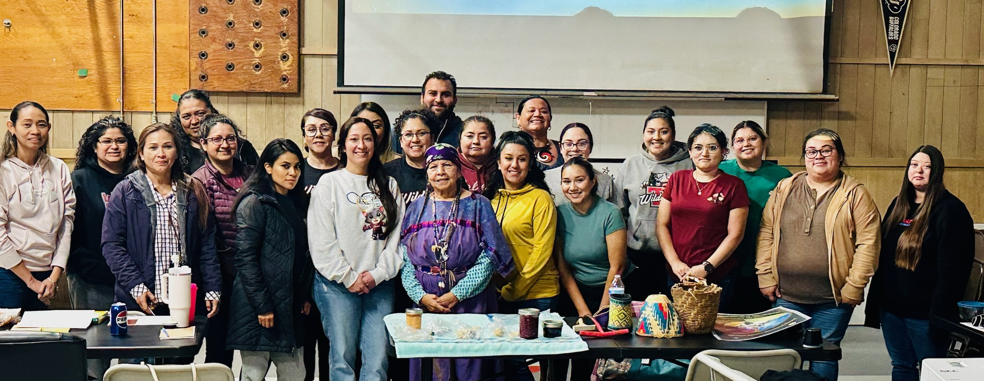
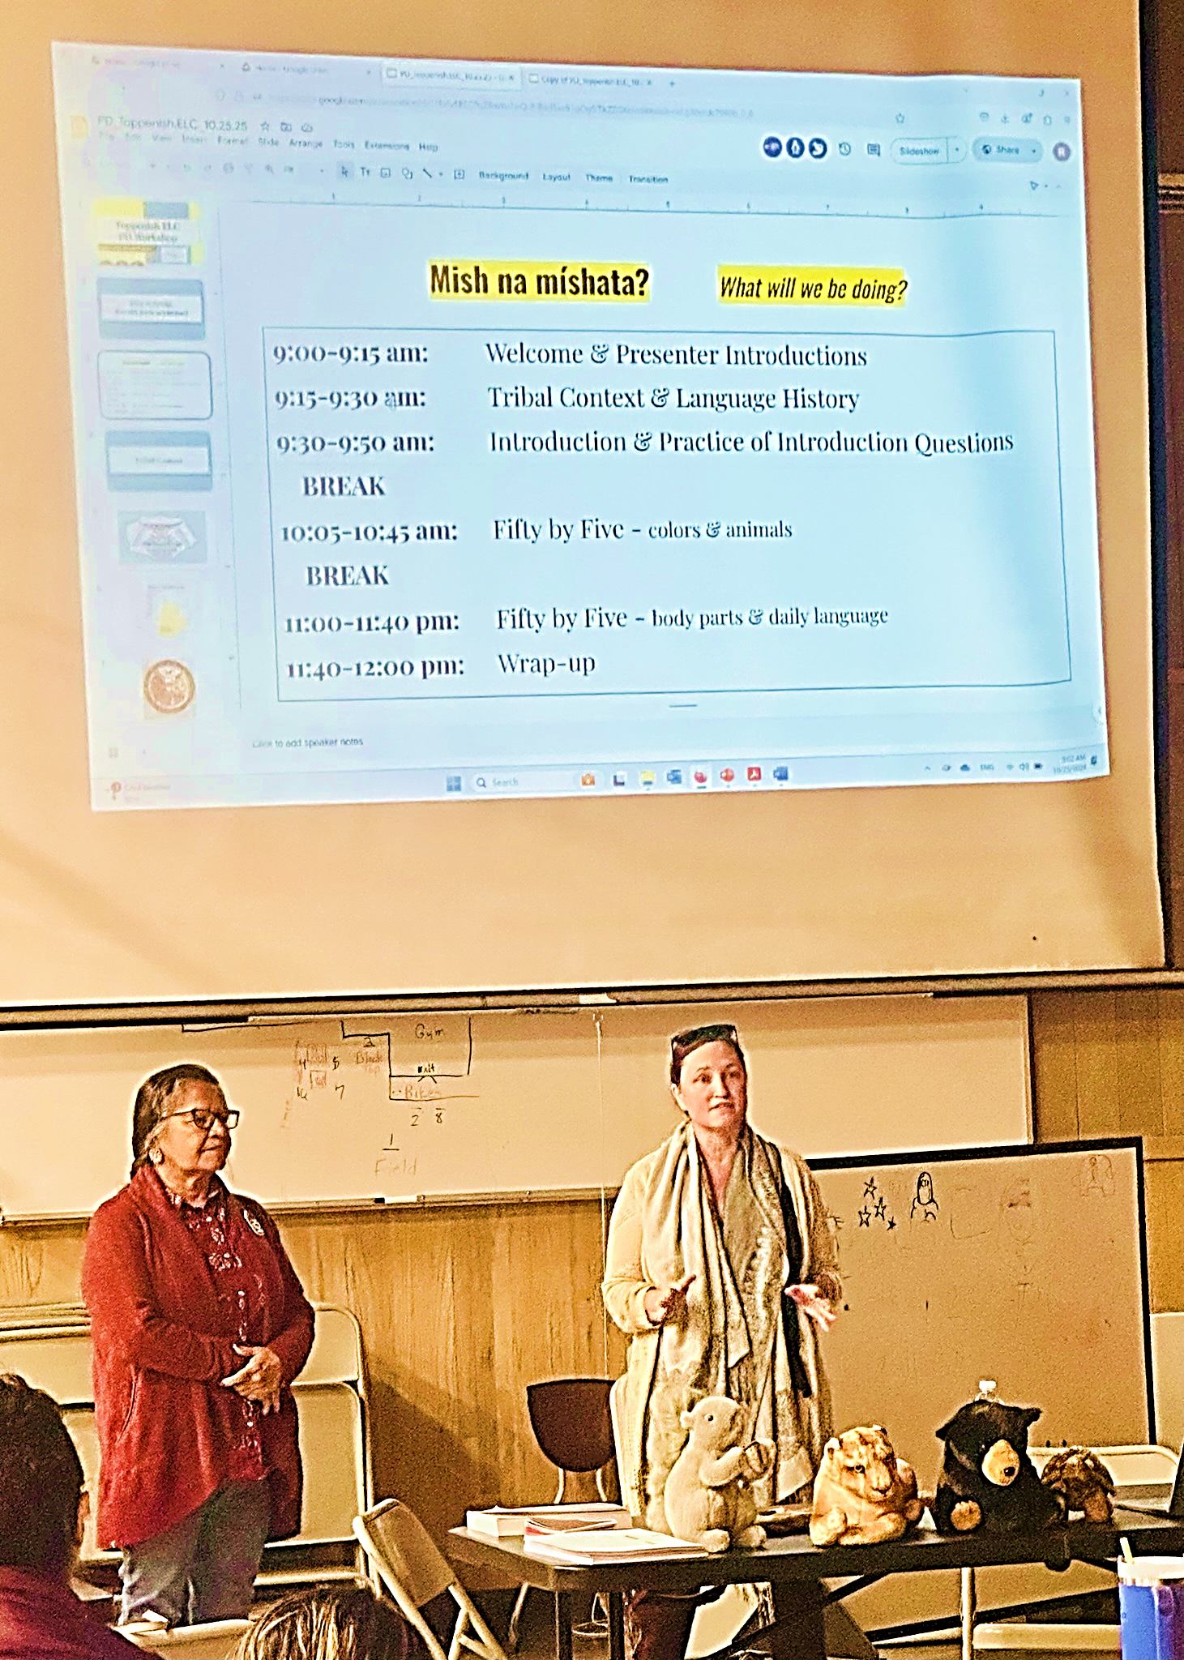
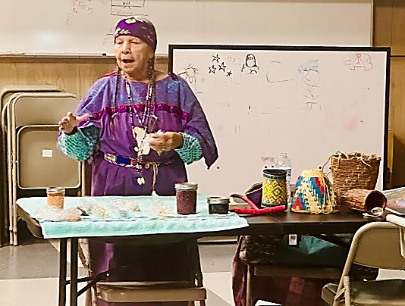
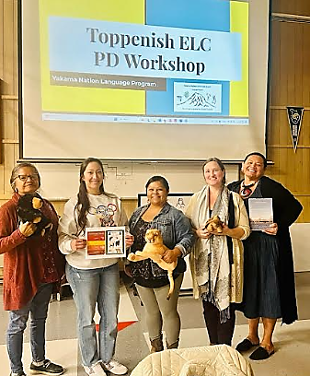
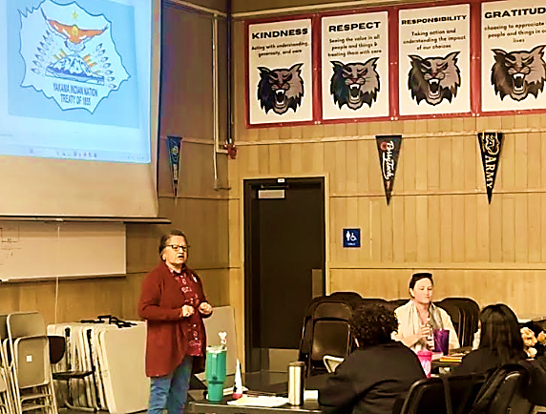
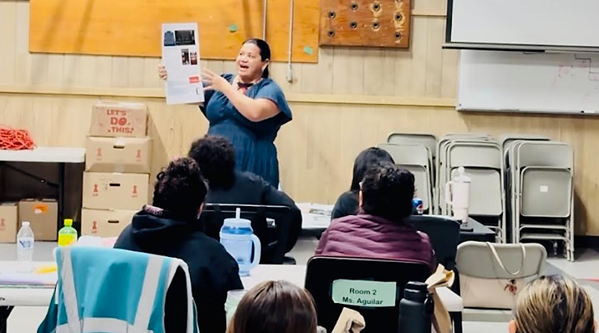

Slide 19
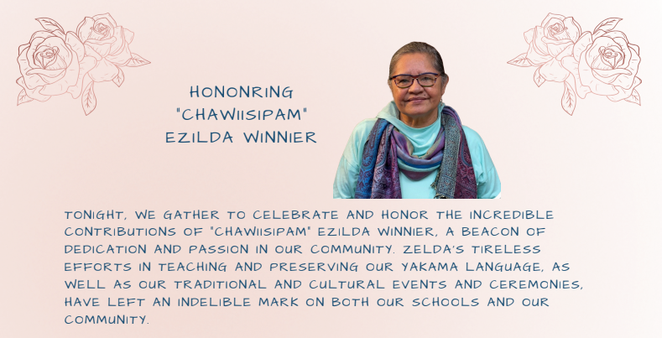
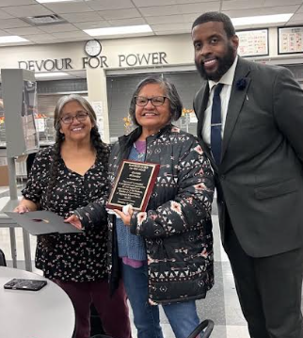

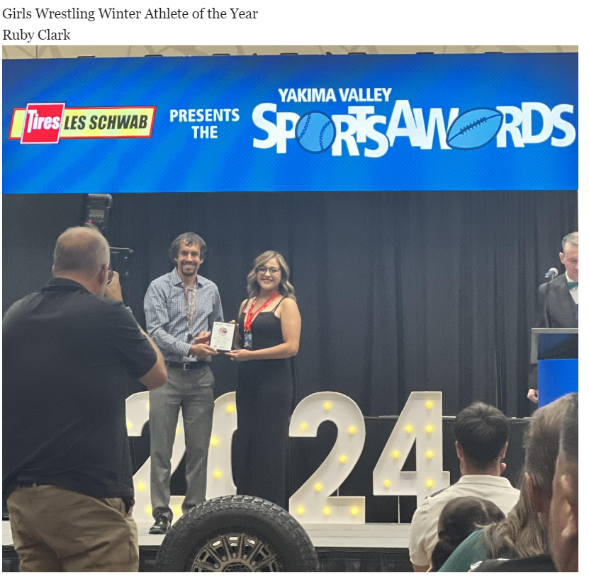
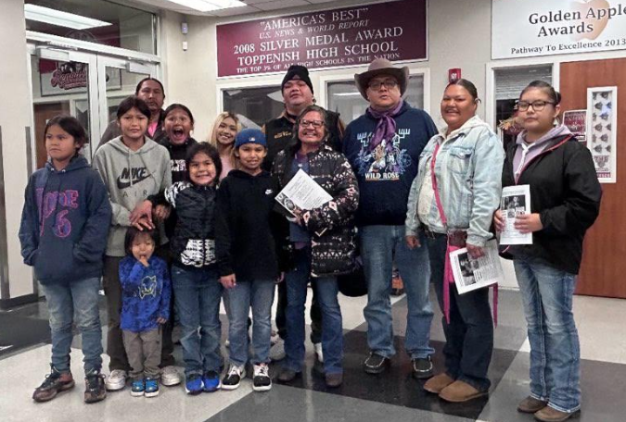
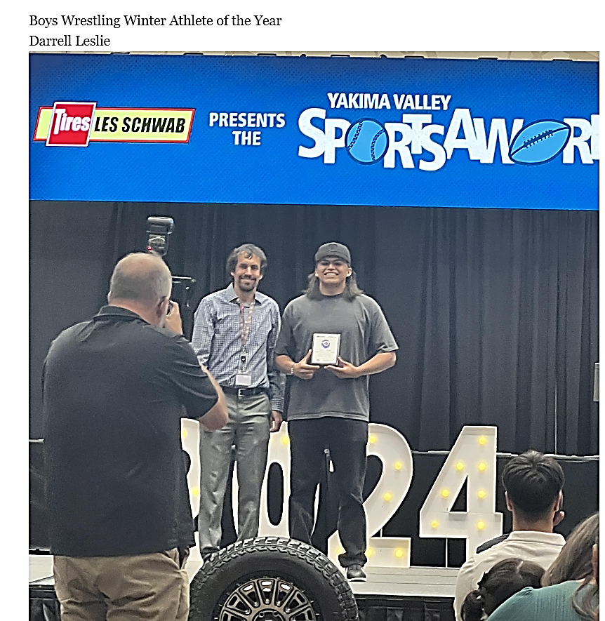
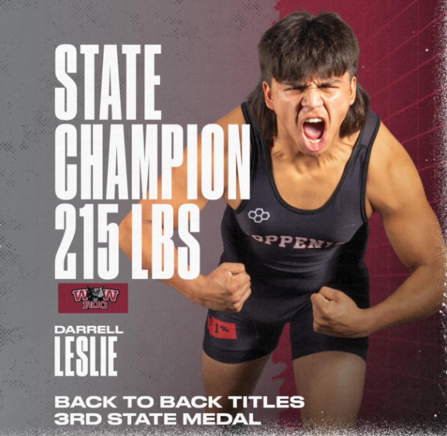
HIGHLIGHTS
HONORING OUR STUDENTS
EZELDA WINNIER
HONORING ELDERS

Slide 20
References
United States Census Bureau: https://www.census.gov/quickfacts/toppenishcitywashington

Slide 21
Questions?

Slide 22
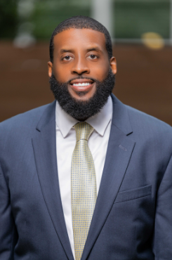
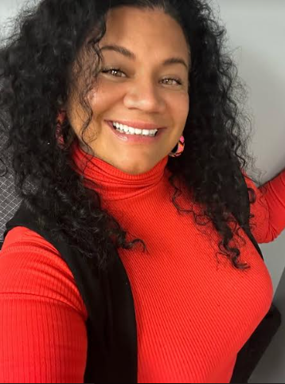
DR. TORON WOOLDRIDGE, Superintendent
Toppenish School District
EMAIL: twooldridge@toppenish.wednet.edu
OFFICE: (509) 865-4455
DR. LOLITA CEJA, Indian Education Director
Toppenish School District
EMAIL: lceja@toppenish.wednet.edu
OFFICE: (509) 865-8322

